Slide 1

SPEAKSURE MEASURE. PRACTICE. EXCEL.
Mentor:
Dr. Arun Kulkarni (HOD – IT)
TEAM NAAG
Ninad Naik 73
Atharva Pandit 12
Atharva Honrao 38
Gaurav Ghade 32

Slide 2
- Dale Carnegie
“There are always
three speeches, for
every speech you gave.
The one you practiced, the one you gave, and one you wish you gave.”
( The Art of Public Speaking )

Slide 3
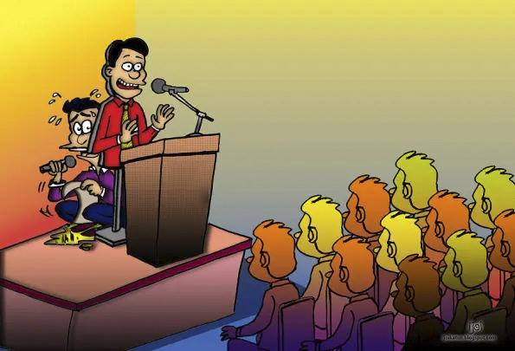
Our Inspiration
Public speaking is a crucial skill in today's world, as a good speech can greatly impact one's success in various aspects of life, from education to the workplace.
However, the lack of practice and feedback often hinder its improvement.

Slide 4
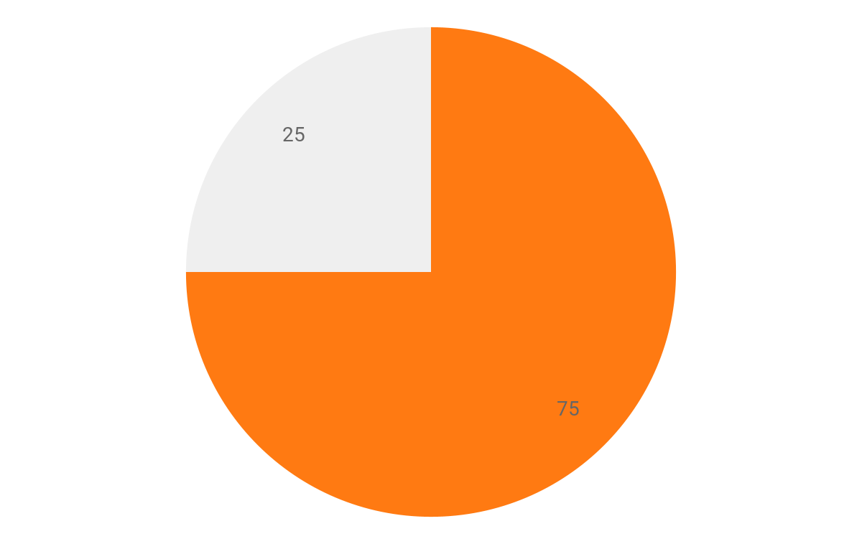
SOME STATS
PEOPLE SUFFERING FROM FEAR OF PUBLIC SPEAKING
It’s estimated that some 15 million people deal with Glossophobia on a daily basis

Slide 5
OUR IDEA
We made an AI application to improve Public Speaking.
Our idea is to help people overcome fear of public speaking so they can talk confidently in front of audience.

Slide 6
OUR MAIN FEATURES
01
02
03
04
Speech Feedback
How fast you speak
Record Progress
Fillers words detection (basically, you know…)

Slide 7
HOW DOES IT WORK?
05
Track progress using graphs
04
Give feedback using Machine Learning model
03
Detect filler words and calculate speech pace
02
Transcripting the speech
01
Record speech and extract features

Slide 8
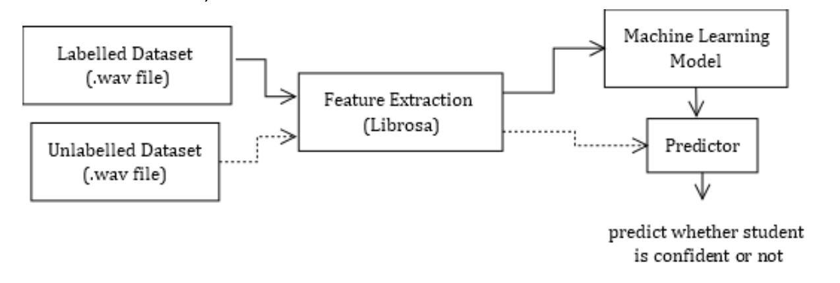
TRAINING AND TESTING MODEL

Slide 9
FILLER WORDS
filler_words = [
'um', 'uh', 'er', 'ah', ‘you know', 'so so’, 'well’, 'basically', 'literally’, 'somewhat', 'more or less’, 'kind of’, 'sort of’, 'maybe', 'perhaps', 'right?’
]

Slide 10
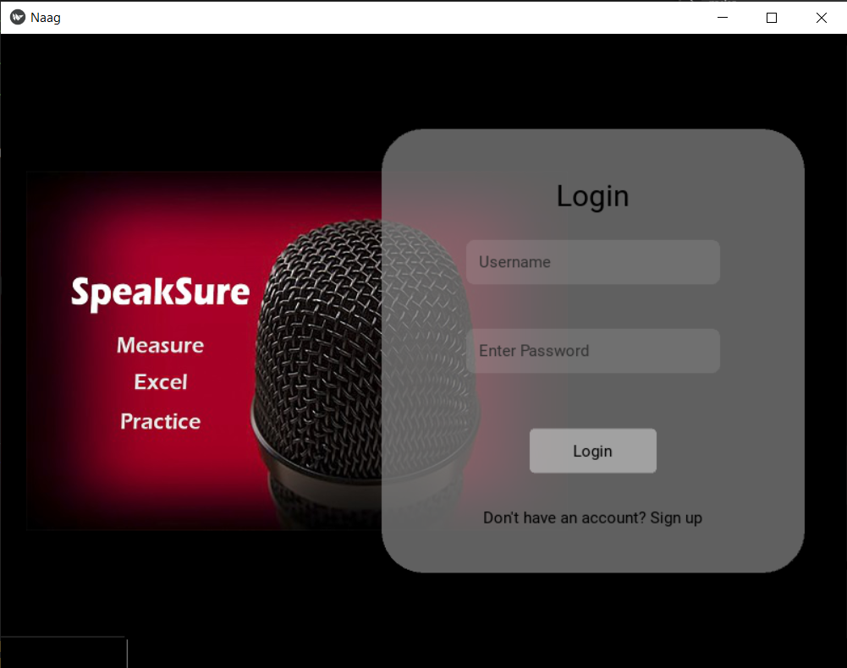
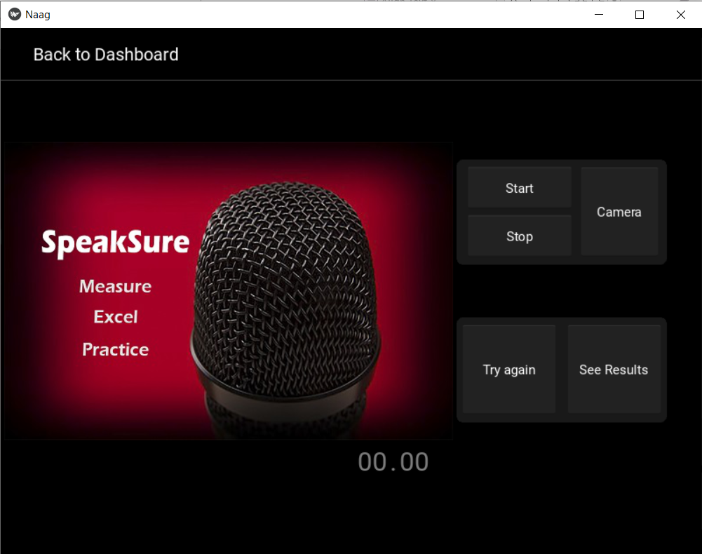
HOW DOES IT LOOK?
Login Page
Recording Page

Slide 11
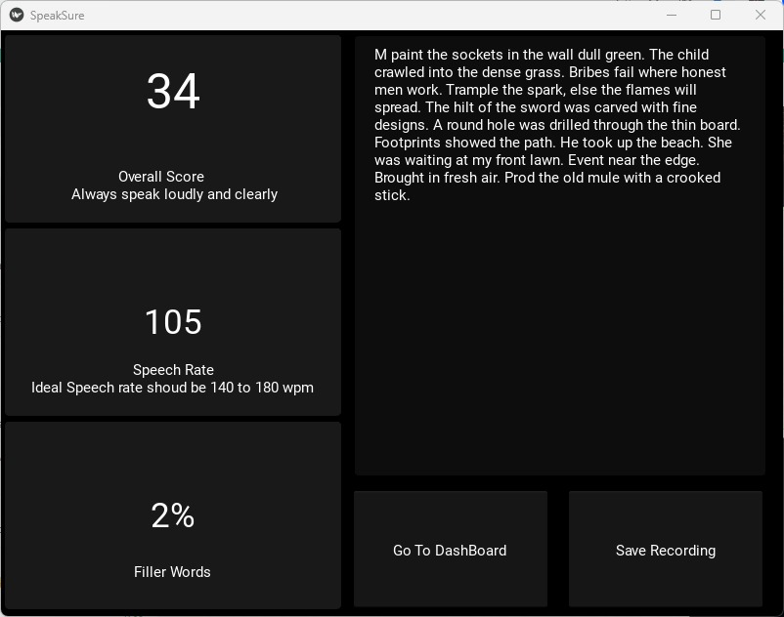
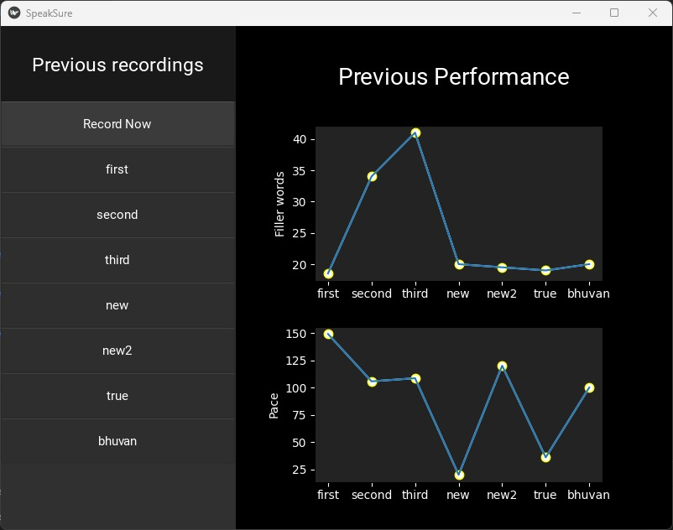
HOW DOES IT LOOK?
Result Page
Dashboard

Slide 12






WHAT HAVE WE USED?
Python
Kivy
scikit learn
Librosa
Assembly AI

Slide 13
FUTURE ASPECTS
A mobile application to record and track progress on-the-go.
This application helps to analyze the person’s confidence level along with the emotions of the person while talking.
This application would help to assist in the candidate employment interview process.
Body gestures can be track using computer vision to give feedback.

Slide 14
OUR REFERENCES
[1] Hui Jiang, Confidence measures for speech recognition: A survey, Speech Communication, Volume 45, Issue 4, 2005, Pages 455-470, https://doi.org/10.1016/j.specom.2004.12.004.
[2] J. G. Borade, A. W. Kiwelekar. L. D. Netak, Automatic Grading of Student’s Presentation Skills based
on PowerPoint Presentation and Audio, 2022 https://doi.org/10.24840/2183-6493_008.002_0008
[3] Grady Williams, Bryan McLellan, Grant Sivesind, Identifying Confidence in Speech, 2017, https://web.stanford.edu/class/cs224s/project/reports _2017/Grady_Williams.pdf

Slide 15
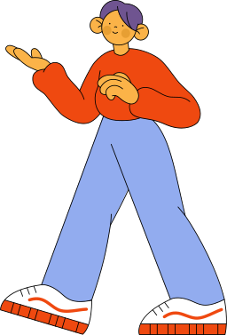
THANKS!
DO YOU HAVE ANY QUESTIONS?

